Slide 1
NeuroVision
EEG based Image Reconstruction
using Deep Learning.

Slide 2
01
Introduction
Memories play a crucial role in the human life experience. Whether they are used to make decisions or understand current situations, memories influence the past, present, and future.
However, some memories are unreliable; in the court of law, the false memories of victims can cause inaccurate verdicts.
To reconstruct human memories directly from the brain, we attempt to use user electroencephalography (EEG) recorded while a subject looks at an image.

Slide 3
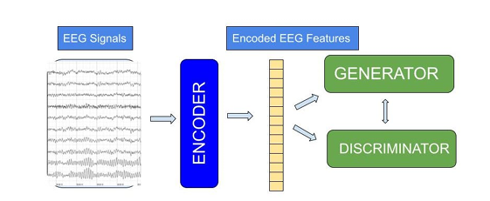
Method :

Slide 4
Progress Till Now :
4
Finished Data
preprocessing
Finalized Data to be used.
3
Combined classes and applied Data Augmentation.
Gathered about 500+ classes each having atleast 25 images
Finalized Technical Approaches
2
Dropped the idea of collecting our own data using equipments in BETic Lab due to time constraints and other isssues.
We will be using pre-existing ImageNet Dataset
1
Problem Statement Defined
LSTM for EEG feature extraction
GAN for grayscale image reconstruction
How to map brain activity through EEG signals back to visual inputs.

Slide 5
References :
Evaluating the ML Models for MindBigData (IMAGENET) of the Brain Signals Priyanka Jain, Mayuresh Panchpor, Saumya Kushwaha and Naveen Kumar Jain, Artificial Intelligence Group, CDAC, Delhi 2022
Deep Learning Human Mind for Automated Visual Classification | September 2, 2016 | Concetto Spampinato, Simone Palazzo, Isaak Kavasidis, Daniela Giordano, Mubarak Shah, Nasim Souly
Reconstructing Static Memories from the Brain with EEG Feature Extraction and Generative Adversarial Networks Matthew Zhang Westlake High School, USA, and Jeremy Lu Saratoga High School, USA 2023
A Novel Approach to Optimize Memory Reconstruction Using Joint Multimodal NetworksJeremy Lu,Cathy Messenger, USA 2023

Slide 6
THANK YOU

